Slide 1
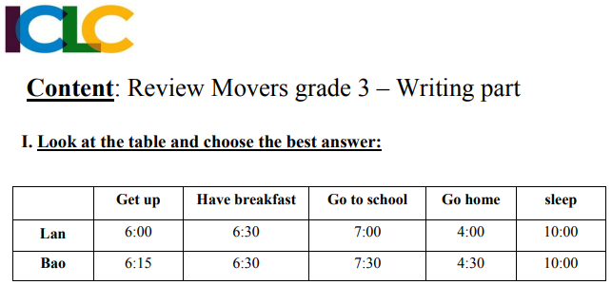
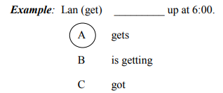

Slide 2
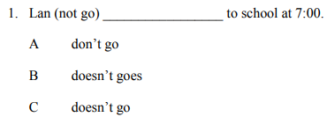
Bao
RIGHT
WRONG
WRONG

Slide 3
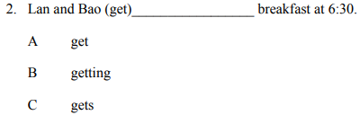
RIGHT
WRONG
WRONG

Slide 4
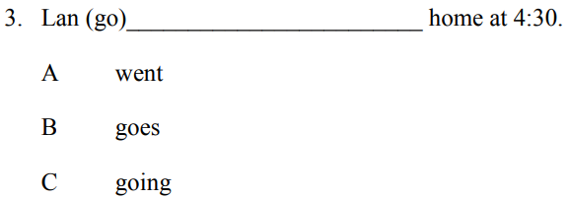
RIGHT
Bao
WRONG
WRONG

Slide 5
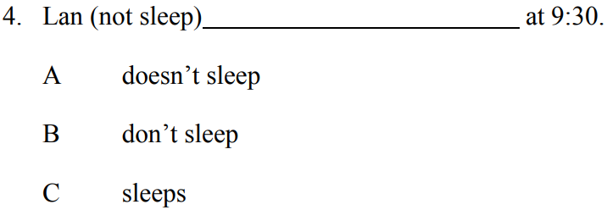
RIGHT
Bao
WRONG
WRONG

Slide 6
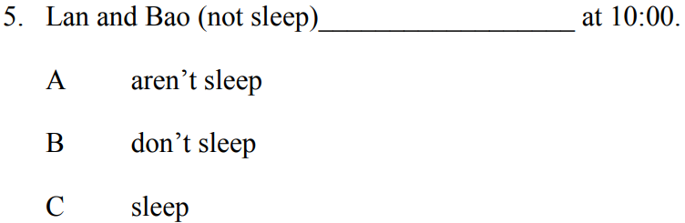
RIGHT
Bao
WRONG
WRONG

Slide 7
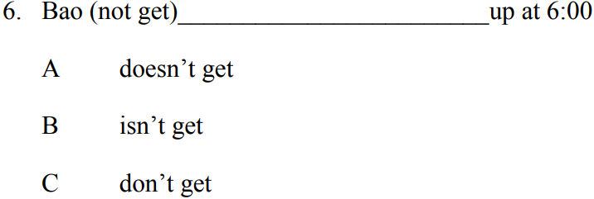
RIGHT
Bao
WRONG
WRONG

Slide 8
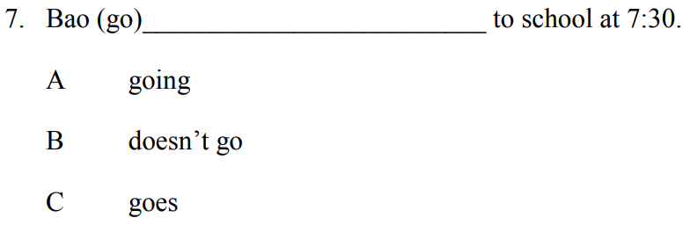
Bao
WRONG
RIGHT
WRONG

Slide 9
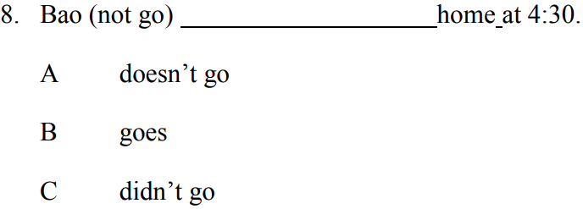
RIGHT
Lan
WRONG
WRONG

Slide 10
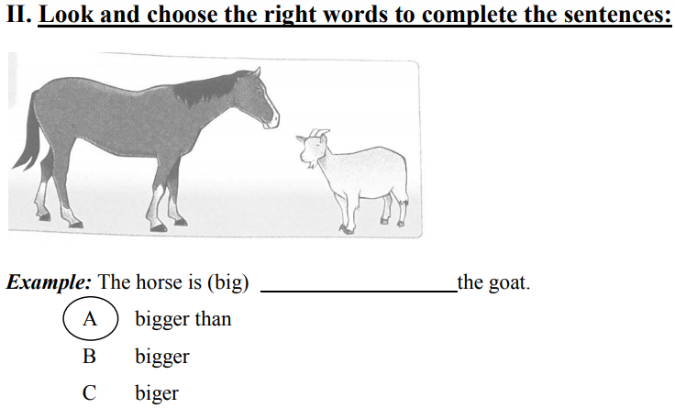

Slide 11
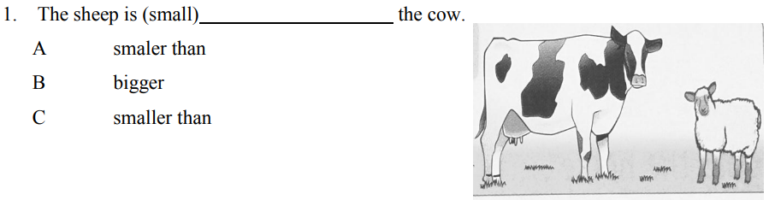
RIGHT
WRONG
WRONG

Slide 12
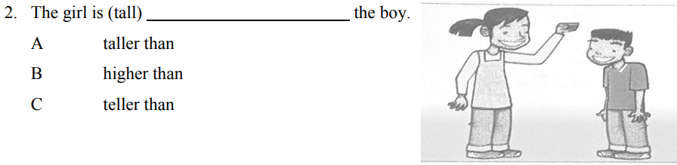
RIGHT
WRONG
WRONG

Slide 13
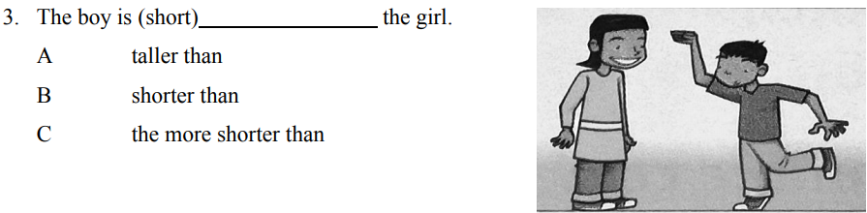
RIGHT
WRONG
WRONG

Slide 14
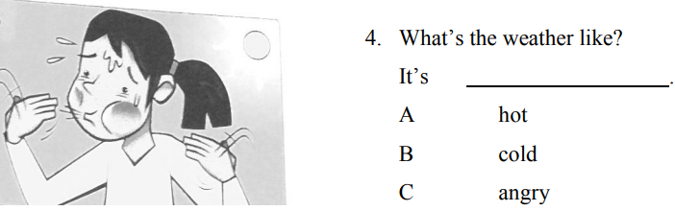
WRONG
RIGHT
WRONG

Slide 15
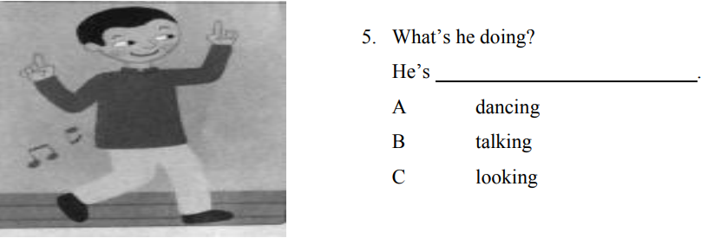
WRONG
RIGHT
WRONG

Slide 16
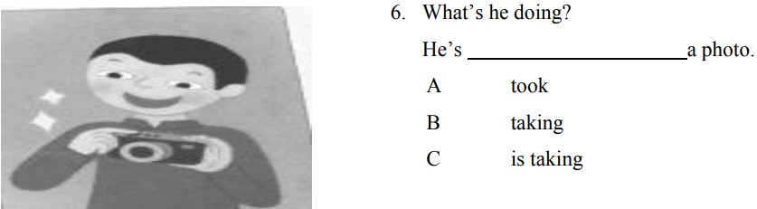
WRONG
RIGHT
WRONG

Slide 17
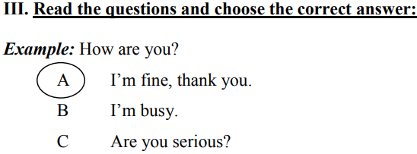

Slide 18
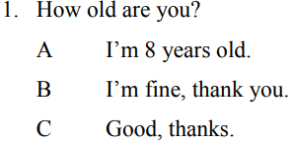
WRONG
RIGHT
WRONG

Slide 19
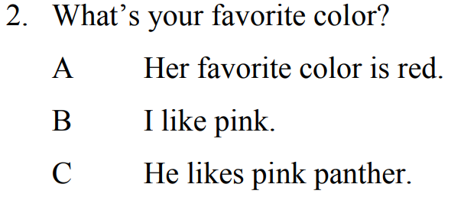
WRONG
RIGHT
WRONG

Slide 20
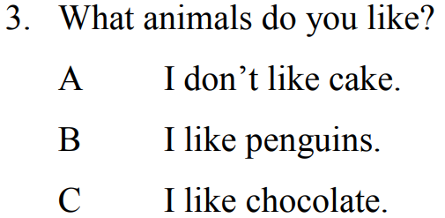
WRONG
RIGHT
WRONG

Slide 21
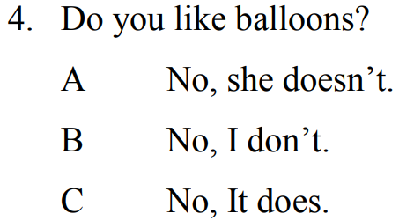
WRONG
RIGHT
WRONG

Slide 22
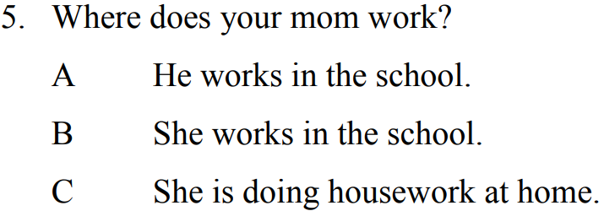
WRONG
RIGHT
WRONG

Slide 23
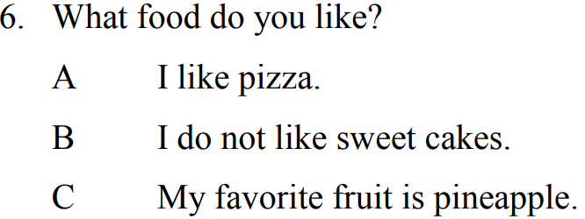
RIGHT
WRONG
WRONG

